Slide 1
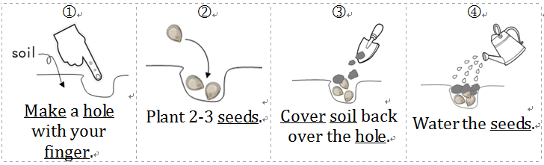
第九大題：閱讀下列短文後回答問題
Tony’s grandpa is a farmer. He has a garden. He grows fruit trees and vegetables. This winter vacation Tony went to his grandpa’s farm. His grandpa taught him how to plant pumpkins. Here is Tony’s note.
Where to plant: An area that gets full sun.
How to plant:

Slide 2
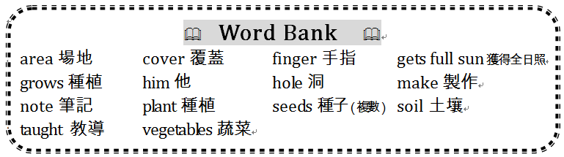

Slide 3
40. Where is a good area to plant pumpkin?
 An area that gets full sun.
 In the bathroom.
● Under a tree.
❍ On a car.

Slide 4
Tony’s grandpa is a farmer. He has a garden. He grows fruit trees and vegetables. This winter vacation Tony went to his grandpa’s farm. His grandpa taught him how to plant pumpkins. Here is Tony’s note.
Where to plant: An area that gets full sun.
How to plant:
 An area that gets full sun.

Slide 5
41. Is summer a good season to plant pumpkin?
 Yes, it does.
 Yes, it is.
● No, it’s not.
❍ No, it doesn’t.

Slide 6
Tony’s grandpa is a farmer. He has a garden. He grows fruit trees and vegetables. This winter vacation Tony went to his grandpa’s farm. His grandpa taught him how to plant pumpkins. Here is Tony’s note.
Where to plant: An area that gets full sun.
How to plant:
● No, it’s not.

Slide 7
42. After plant 2-3 seeds, can Tony water the seeds directly直接地?
 No, he can’t.
 Yes, he can.
● Yes, he does.
❍ No, he doesn’t.

Slide 8
Tony’s grandpa is a farmer. He has a garden. He grows fruit trees and vegetables. This winter vacation Tony went to his grandpa’s farm. His grandpa taught him how to plant pumpkins. Here is Tony’s note.
Where to plant: An area that gets full sun.
How to plant:
 No, he can’t.

Slide 9
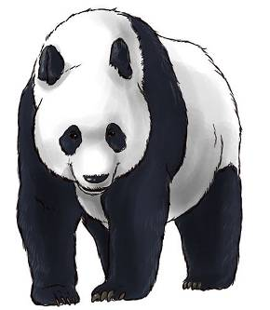
Giant Panda
Giant pandas live in the rainy mountains. They live in the bamboo forests of southwestern China. Pandas only eat bamboo shoots and leaves.
After the age of six, mother giant pandas begin to have cubs. A cub nurses for four months and then begins to eat bamboo. By the age of six months, it no longer nurses.
There are 3 pandas in Taipei Zoo. The name of the baby panda is圓仔. It was born in 2013. It is a female panda and 9 months old. Do you like the baby panda?
資料來源：改編自National Geographic Kids。

Slide 10
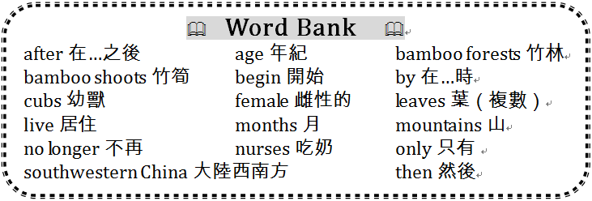

Slide 11
43. Do giant pandas live in plains平原?
 No, they are not.
 Yes, they do.
● No, they don’t.
❍ Yes, they are.

Slide 12
Giant Panda
Giant pandas live in the rainy mountains. They live in the bamboo forests of southwestern China. Pandas only eat bamboo shoots and leaves.
After the age of six, mother giant pandas begin to have cubs. A cub nurses for four months and then begins to eat bamboo. By the age of six months, it no longer nurses.
There are 3 pandas in Taipei Zoo. The name of the baby panda is圓仔. It was born in 2013. It is a female panda and 9 months old. Do you like the baby panda?
資料來源：改編自National Geographic Kids。
● No, they don’t.

Slide 13
44. Does圓仔eat bamboo now現在?
 Yes, it does.
 No, it doesn’t.
● Yes, it is.
❍ No, it isn’t.

Slide 14
Giant Panda
Giant pandas live in the rainy mountains. They live in the bamboo forests of southwestern China. Pandas only eat bamboo shoots and leaves.
After the age of six, mother giant pandas begin to have cubs. A cub nurses for four months and then begins to eat bamboo. By the age of six months, it no longer nurses.
There are 3 pandas in Taipei Zoo. The name of the baby panda is圓仔. It was born in 2013. It is a female panda and 9 months old. Do you like the baby panda?
資料來源：改編自National Geographic Kids。
 Yes, it does.

Slide 15
45. Does圓仔nurse?
 Yes, it does.
 No, it doesn’t.
● Yes, it is.
❍ No, it isn’t.

Slide 16
Giant Panda
Giant pandas live in the rainy mountains. They live in the bamboo forests of southwestern China. Pandas only eat bamboo shoots and leaves.
After the age of six, mother giant pandas begin to have cubs. A cub nurses for four months and then begins to eat bamboo. By the age of six months, it no longer nurses.
There are 3 pandas in Taipei Zoo. The name of the baby panda is圓仔. It was born in 2013. It is a female panda and 9 months old. Do you like the baby panda?
資料來源：改編自National Geographic Kids。
 No, it doesn’t.

Slide 17
46. Can 圓仔have cubs in 2018?
 No, it can’t.
 Yes, it can.
● Yes, it does.
❍ No, it doesn’t.

Slide 18
Giant Panda
Giant pandas live in the rainy mountains. They live in the bamboo forests of southwestern China. Pandas only eat bamboo shoots and leaves.
After the age of six, mother giant pandas begin to have cubs. A cub nurses for four months and then begins to eat bamboo. By the age of six months, it no longer nurses.
There are 3 pandas in Taipei Zoo. The name of the baby panda is圓仔. It was born in 2013. It is a female panda and 9 months old. Do you like the baby panda?
資料來源：改編自National Geographic Kids。
 No, it can’t.

