Slide 1
第十大題：請先閱讀下列短文，並選出合適的答案。【Part A】
Things like candy and cola are “junk food”. Junk food sometimes tastes good, but they are bad for you. Junk food are full of sugar. Eating a lot of sugar is not healthy. It can make you sick.
Everyone should eat healthy food. Fresh local fruits and vegetables are good for your body and the environment.
You can try to cook at home with your family. You can help to prepare lunch or dinner in the kitchen. Try to make some hand-made cookies or dumplings. It’s very fun and exciting.

Slide 2
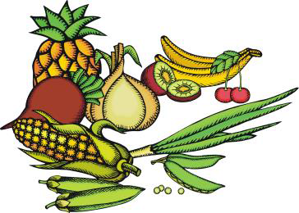
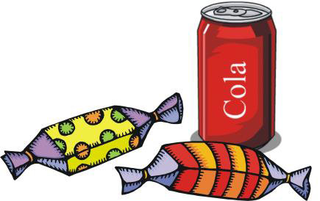
junk 垃圾 full of 滿滿都是 sugar糖 healthy健康的
fresh新鮮的 local當地的 vegetables 蔬菜 environment環境
prepare 準備 hand-made 手工製作

Slide 3
44. Which one is junk food?
① An apple.
② Candy
③ Tea
④ Lemon juice

Slide 4
第十大題：請先閱讀下列短文，並選出合適的答案。【Part A】
Things like candy and cola are “junk food”. Junk food sometimes tastes good, but they are bad for you. Junk food are full of sugar. Eating a lot of sugar is not healthy. It can make you sick.
Everyone should eat healthy food. Fresh local fruits and vegetables are good for your body and the environment.
You can try to cook at home with your family. You can help to prepare lunch or dinner in the kitchen. Try to make some hand-made cookies or dumplings. It’s very fun and exciting.
② Candy

Slide 5
45. What can make you sick?
① Eat a lot of soup.
② Eat a lot of rice.
③ Eat a lot of vegetables.
④ Eat a lot of sugar.

Slide 6
第十大題：請先閱讀下列短文，並選出合適的答案。【Part A】
Things like candy and cola are “junk food”. Junk food sometimes tastes good, but they are bad for you. Junk food are full of sugar. Eating a lot of sugar is not healthy. It can make you sick.
Everyone should eat healthy food. Fresh local fruits and vegetables are good for your body and the environment.
You can try to cook at home with your family. You can help to prepare lunch or dinner in the kitchen. Try to make some hand-made cookies or dumplings. It’s very fun and exciting.
④ Eat a lot of sugar.

Slide 7
46. How can you live a healthy life?

① Eat more candy.
② Drink Cola everyday.
③ Eat fresh fruits.
④ Go to bed at 1:00AM.

Slide 8
第十大題：請先閱讀下列短文，並選出合適的答案。【Part A】
Things like candy and cola are “junk food”. Junk food sometimes tastes good, but they are bad for you. Junk food are full of sugar. Eating a lot of sugar is not healthy. It can make you sick.
Everyone should eat healthy food. Fresh local fruits and vegetables are good for your body and the environment.
You can try to cook at home with your family. You can help to prepare lunch or dinner in the kitchen. Try to make some hand-made cookies or dumplings. It’s very fun and exciting.
③ Eat fresh fruits

Slide 9
47. What is good for the environment?
① Eat local vegetables.
② Play computer games.
③ Eat more beef.
④ Take a bath everyday.

Slide 10
第十大題：請先閱讀下列短文，並選出合適的答案。【Part A】
Things like candy and cola are “junk food”. Junk food sometimes tastes good, but they are bad for you. Junk food are full of sugar. Eating a lot of sugar is not healthy. It can make you sick.
Everyone should eat healthy food. Fresh local fruits and vegetables are good for your body and the environment.
You can try to cook at home with your family. You can help to prepare lunch or dinner in the kitchen. Try to make some hand-made cookies or dumplings. It’s very fun and exciting.
① Eat local vegetables.

Slide 11
【Part B】
Yo-Yo Ma is a famous cello player. He gives concerts in many countries. He also plays on TV shows and music CDs. Yo-Yo Ma plays with a lot of feelings. People love to hear him play. And, he is very friendly to his fans.

Slide 12
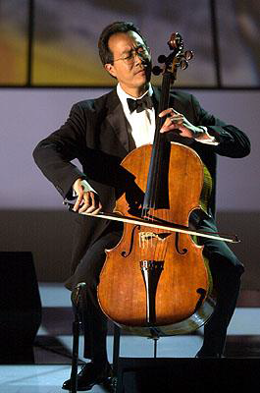
famous 有名的 cello大提琴
concert 演唱會/演奏會
feelings感情 hear 聆聽
friendly 友善 fans樂迷

Slide 13
48. Why do people like Yo-Yo Ma?
①They like his book.
②They like his music.
③They like his food.
④They like his dance.

Slide 14
【Part B】
Yo-Yo Ma is a famous cello player. He gives concerts in many countries. He also plays on TV shows and music CDs. Yo-Yo Ma plays with a lot of feelings. People love to hear him play. And, he is very friendly to his fans.
② They like his music.

Slide 15
49. Where can’t you hear Yo-Yo Ma’s music?
①On TV shows.
②In the post office.
③On music CDs.
④In music concerts.

Slide 16
【Part B】
Yo-Yo Ma is a famous cello player. He gives concerts in many countries. He also plays on TV shows and music CDs. Yo-Yo Ma plays with a lot of feelings. People love to hear him play. And, he is very friendly to his fans.
②In the post office.

Slide 17
50. What is true about Yo-Yo Ma?
①He loves music very much.
②He is a doctor.
③He can draw very well.
④He is a basketball player.

Slide 18
【Part B】
Yo-Yo Ma is a famous cello player. He gives concerts in many countries. He also plays on TV shows and music CDs. Yo-Yo Ma plays with a lot of feelings. People love to hear him play. And, he is very friendly to his fans.
①He loves music very much.

