Slide 1
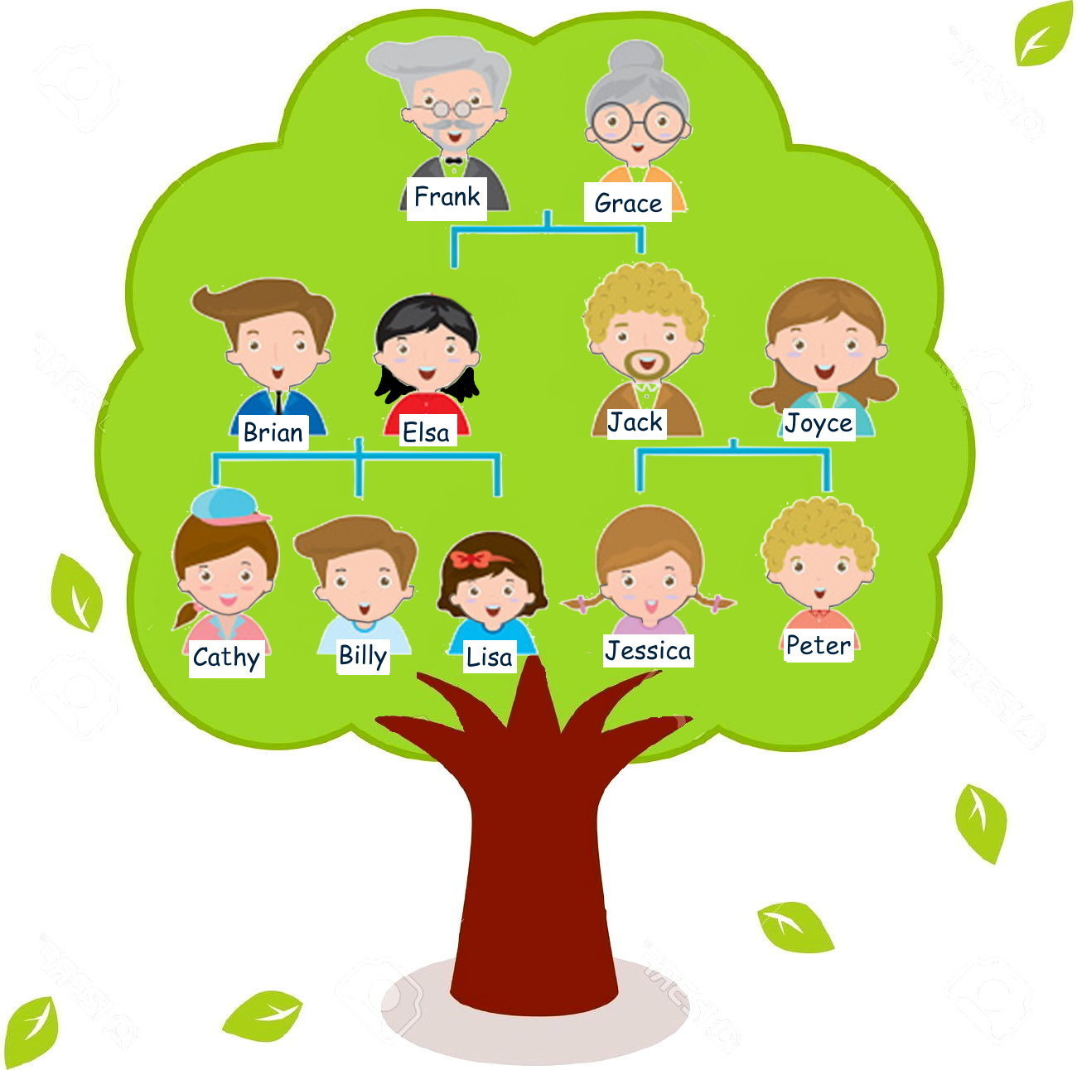
第十四大題：看圖表找資訊
wife太太 children孩子 study念書

Slide 2
This is my family. Jack is my brother. He is a cook. He has two children. Peter is twelve years old and Jessica is ten years old. Elsa is my wife and she is a nurse. I have three children. Cathy is thirteen years old, Billy is eleven years old, and Lisa is four years old. They study in my school. I am a teacher.

Slide 3
44. Who is Jessica’s mother?
Peter.
Grace.
Joyce.
❍ Elsa.

Slide 4
第十四大題：看圖表找資訊
wife太太 children孩子 study念書

Slide 5
45. Where does Elsa work?
Hospital.
School.
Home.
❍ Police station.

Slide 6
This is my family. Jack is my brother. He is a cook. He has two children. Peter is twelve years old and Jessica is ten years old. Elsa is my wife and she is a nurse. I have three children. Cathy is thirteen years old, Billy is eleven years old, and Lisa is four years old. They study in my school. I am a teacher.
Hospital.

Slide 7
46. Who am “I”?
Frank.
Joyce
Grace.
❍ Brian

Slide 8
This is my family. Jack is my brother. He is a cook. He has two children. Peter is twelve years old and Jessica is ten years old. Elsa is my wife and she is a nurse. I have three children. Cathy is thirteen years old, Billy is eleven years old, and Lisa is four years old. They study in my school. I am a teacher.

Slide 9
第十四大題：看圖表找資訊
wife太太 children孩子 study念書
❍ Brian

Slide 10
第十五大題：閱讀測驗
Peter: I want to catch some Pokémon. Do you want to go with me?
Mary: What is “Pokémon”?
Peter: It’s a hot online game. People started to play this game in Japan.
Mary: Oh, I see. Is it fun?
Peter: Of course! Many people go to parks, train stations late at
night with their cellphones.
Mary: Do they go there to catch different Pokémon?
Peter: Yes, they do. It’s good for people to go out and get to know
new places.
Mary: But it’s very dangerous to look at your cellphone screen when
you are walking and catching Pokémon. Accidents may
happen.

Slide 11

catch 抓 Pokémon寶可夢 people人們 start 開始 Japan日本 with 用 cellphone 手機 different 不同的 place 地方
dangerous 危險的 screen 螢幕 accident意外 happen發生

Slide 12
47. What is a “hot” online game?
People eat hot food. .
Food is very hot.
People love the game very much.
❍ People don’t like the game.

Slide 13
第十五大題：閱讀測驗
Peter: I want to catch some Pokémon. Do you want to go with me?
Mary: What is “Pokémon”?
Peter: It’s a hot online game. People started to play this game in Japan.
Mary: Oh, I see. Is it fun?
Peter: Of course! Many people go to parks, train stations late at
night with their cellphones.
Mary: Do they go there to catch different Pokémon?
Peter: Yes, they do. It’s good for people to go out and get to know
new places.
Mary: But it’s very dangerous to look at your cellphone screen when
you are walking and catching Pokémon. Accidents may
happen.
③ People love the game very much.

Slide 14
48. You can catch Pokémon with a
___________.
CD player.
cellphone
book.
❍ pencil case

Slide 15
第十五大題：閱讀測驗
Peter: I want to catch some Pokémon. Do you want to go with me?
Mary: What is “Pokémon”?
Peter: It’s a hot online game. People started to play this game in Japan.
Mary: Oh, I see. Is it fun?
Peter: Of course! Many people go to parks, train stations late at
night with their cellphones.
Mary: Do they go there to catch different Pokémon?
Peter: Yes, they do. It’s good for people to go out and get to know
new places.
Mary: But it’s very dangerous to look at your cellphone screen when
you are walking and catching Pokémon. Accidents may
happen.
② cellphone

Slide 16
49. Why do people go to parks at night?
To catch Pokémon.
To catch volleyball.
To play basketball.
❍ To swim.

Slide 17
第十五大題：閱讀測驗
Peter: I want to catch some Pokémon. Do you want to go with me?
Mary: What is “Pokémon”?
Peter: It’s a hot online game. People started to play this game in Japan.
Mary: Oh, I see. Is it fun?
Peter: Of course! Many people go to parks, train stations late at
night with their cellphones.
Mary: Do they go there to catch different Pokémon?
Peter: Yes, they do. It’s good for people to go out and get to know
new places.
Mary: But it’s very dangerous to look at your cellphone screen when
you are walking and catching Pokémon. Accidents may
happen.
①To catch Pokémon.

Slide 18
50. Which one is true?
There are no Pokémon outdoors.
Different cellphones catch different Pokémon.
It’s good for people to go out.
❍ It’s good to stay at home.

Slide 19
第十五大題：閱讀測驗
Peter: I want to catch some Pokémon. Do you want to go with me?
Mary: What is “Pokémon”?
Peter: It’s a hot online game. People started to play this game in Japan.
Mary: Oh, I see. Is it fun?
Peter: Of course! Many people go to parks, train stations late at
night with their cellphones.
Mary: Do they go there to catch different Pokémon?
Peter: Yes, they do. It’s good for people to go out and get to know
new places.
Mary: But it’s very dangerous to look at your cellphone screen when
you are walking and catching Pokémon. Accidents may
happen.
③It’s good for people to go out.

